Slide 1
Ireland At-Sea Sampling Case Study
WKRDB-POP
18/2/2019
David Currie

Slide 2
Sampling Design
From 2017 Q3 the MI’s demersal at-sea catch sampling programme was changed to a 4S programme.
Sampling frame: Irish registered vessels >10m length using the gear types OTB, SSC, GNS and TBB and with target assemblages DEF and CRU
Stratified temporally (year and quarter) and spatially (based on which ICES areas the majority of their fishing activity occurred in the same quarter in the previous year)
  3 vessel lists per quarter (vessels mostly fishing in 6, mostly fishing in 7a and mostly fishing in 7b-k)
Random selections are then made from these lists and sampling coordinators then try and contact the selected vessels to arrange trips for at-sea observers to sample.
Vessels are selected with unequal probability, based on their length and the number of trips they have previously made. No clustering or sub-sampling is used.

Slide 3
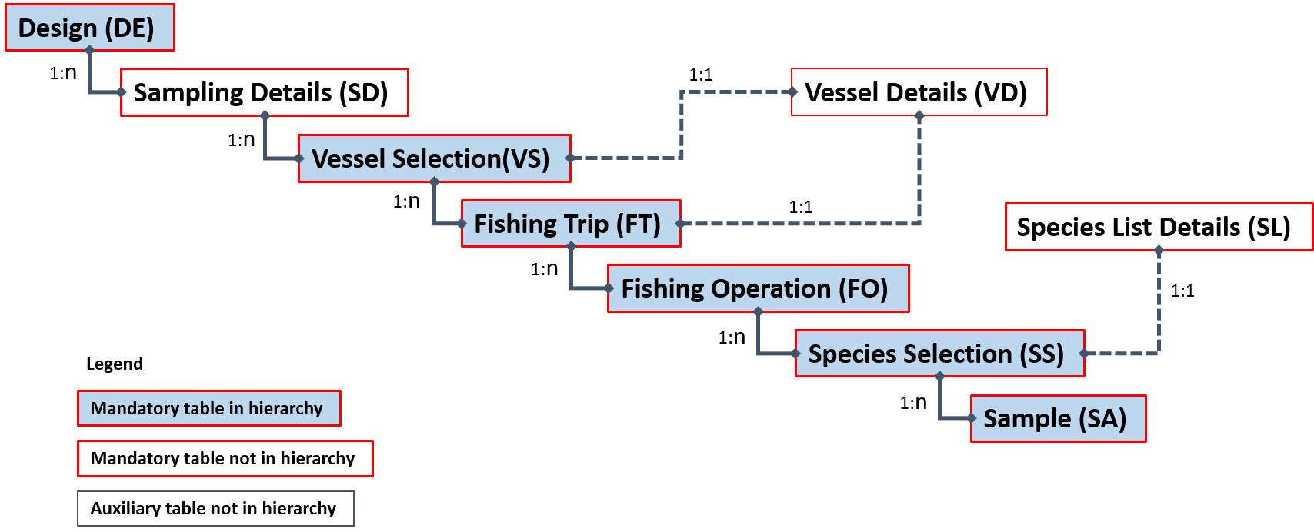
Attempt 1 – Hierarchy 1
Hierarchy 1 thought to be most appropriate

Slide 4
Attempt 1 – Hierarchy 1
During population of the model a problem with vessel stratification was identified
3 vessel lists per quarter (vessels mostly fishing in 6, mostly fishing in 7a and mostly fishing in 7b-k)
3 strata per quarter
  2017-Q3-7bk, 2017-Q3-7a,2017-Q3-6ab
  2017-Q4-7bk, 2017-Q4-7a,2017-Q4-6ab
But a vessel can be in multiple strata e.g. 2017-Q3-7bk and 2017-Q4-7bk – NOT ALLOWED
So, can’t stratify the vessel selection by things that aren’t actually properties of the vessel

Slide 5
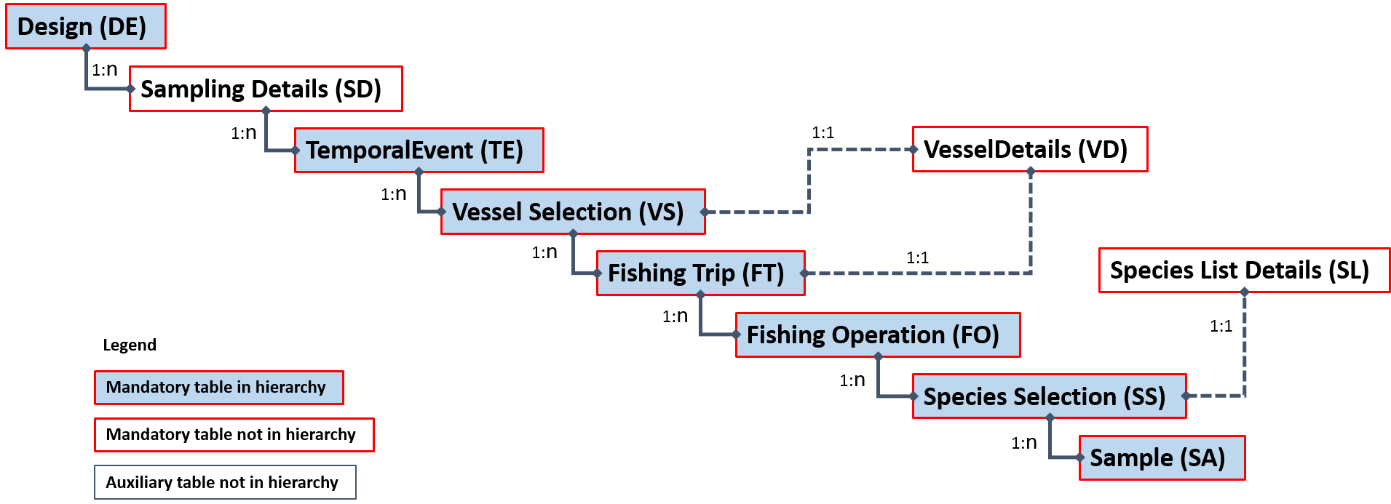
Attempt 2 – Hierarchy 3
Hierarchy 3 includes a temporal element

Slide 6
Attempt 2 – Hierarchy 3
Sampling Details
  All sampling is done by the Marine Institute so this table is simple to complete.
Temporal Event
  The sampling is stratified by year and quarter – these are defined in this table.

Slide 7
Attempt 2 – Hierarchy 3
Vessel Selection
  Stratified by Year, Quarter and Area.
  Within each stratum the total number of relevant vessels is calculated from the vessel draw list data and used for the “VStotal” value, and the number of those vessels that we actually sampled is calculated from our sampling database and used for the “VSsampled” value.
  Vessels are selected using “Unequal Probability Sampling With Replacement” so the VSselectionMethod value is “UPSWR” – the probability value was taken from the vessel draw lists.
  We also ended up sampling some vessels that weren’t on the vessel selection lists – these have been put into their own stratum (“2017-Qn-Other”), with a selection method of “Expert Judgment”.
  All sampling is done by observers. Each Vessel Selection row is linked to a vessel in the Vessel Details table.

Slide 8
Attempt 2 – Hierarchy 3
Vessel Details
  This is simply derived from our vessel register data – only vessels we have sampled are included.
Fishing Trip
  This contains data for the trips we sampled. When a vessel is randomly selected then the sampling coordinators will try and contact the skipper to arrange to send an observer on a trip. A selection method of Ad-hoc sampling (NPAH) has been used to show that the actual fishing trip an observer is present on is not randomly selected. The situations when it is not possible to contact the skipper or they refuse to accept an observer are not currently included in this data.
  The number of trips we sampled for that Year/Quarter/Vessel can be calculated from our sampling database and used for the value of “FTsampled”, the number of fishing trips that vessel made in that year/quarter can be calculated from logbooks data and used for “FTtotal”.
  The details of the trip such as the number of hauls are recorded in our sampling database. The departure and arrival location and dates are recorded in both our sampling and logbooks databases.
  The FishingTrip data is linked to the same VesselDetails records as the relevant VesselSelection record i.e. I assume there have been no changes in the vessel details between the time where we stratify the vessels and the time when we sample them.

Slide 9
Attempt 2 – Hierarchy 3
Fishing Operation
  Our sampling database has a record for each haul made, its date, time, and location, its validity, and whether we sampled it or not. This data is used to populate this table. We don’t stratify the hauls for sampling. We can calculate the total number of hauls for each trip (“FOtotal”) and the number of hauls we sampled (“FOsampled”) – I have chosen expert judgement (NPEJ) sampling as the appropriate selection method.
  Each Irish fishing trip in our logbooks database is assigned a metier – we then match the fishing trips in our sampling database to the logbooks database so that each Fishing Operation has a metier.
  For this at-sea programme we record length data at the haul level but biological data is only recorded at the trip level – to allow for this fishing operation records have an FOaggregationLevel of either H or T. Our length samples will be linked to the H rows, whilst our biological samples will be linked to T rows.

Slide 10
Attempt 2 – Hierarchy 3
Species List Details
  The sampling programme protocol describes which species should be sampled but this is not prescriptive – the guidance is “Ensure at all times that the discard sample is representative of the discards taken in the catch. It is important to sample discards and landings of the same species from the same haul. They must be sampled representatively.”
  As a work-around I just generated a list based on the species that we actually sampled during 2017.
  We have revised this approach so that your species list should just include species that you will definitely sample if they are there. You can still have samples from species that aren’t on your species list though.

Slide 11
Attempt 2 – Hierarchy 3
Species Selection
  The Species Selection table provides a link between the Fishing Operation and the Sample tables. It describes which Species List was used to decide which species to sample, and how many of those target species were present in the fishing operation.
  For example, if we had a list of 30 species we might take landing samples from, 15 of those species were present in the haul, and we sampled 10 of those species then we would have an SStotal value of 15 and an SSsampled value of 10 for the landing samples from that haul.
  However, based on our sampling protocols we cannot assume that because a species was not sampled it was not present in the haul. For the landings we record the bulk, so we can calculate SStotal, however this is not currently possible for the discards.

Slide 12
Attempt 2 – Hierarchy 3
Sample
  We don’t have sub-sampling so I did not need multiple levels of Sample tables. The unique restrictions on the Sample table meant that I had to group and aggregate our sampling data – this meant that I couldn’t easily allocate a national code (SAnationalCode) to each entry in the Sample table.
  We don’t record the total weight of each species in the haul so the value of SAtotal had to be estimated based on average ratios between the amount of fish caught and sampled. For length samples the weight of the fish had to be calculated using a/b parameters.

Slide 13
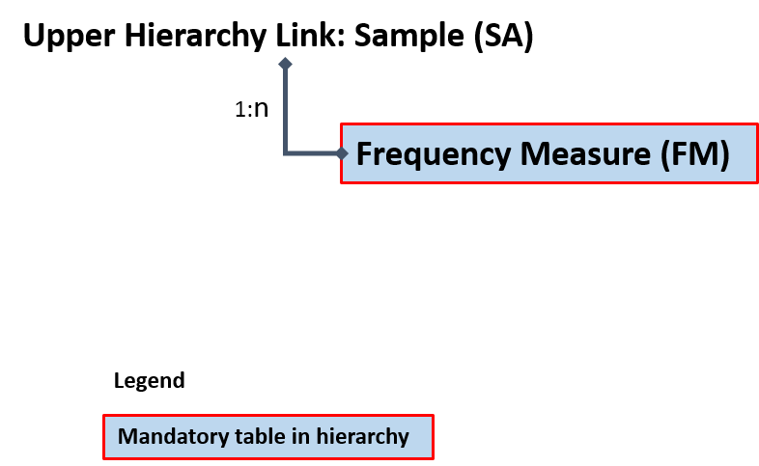
Attempt 2 – Hierarchy 3
There are 2 different lower hierarchies used.
  Length-frequency samples have a SAlowerHierarchy value of B
  Biological samples have a SAlowerHierarchy value of C.
Frequency Measure
  The Length-Frequency sample data is recorded here.

Slide 14
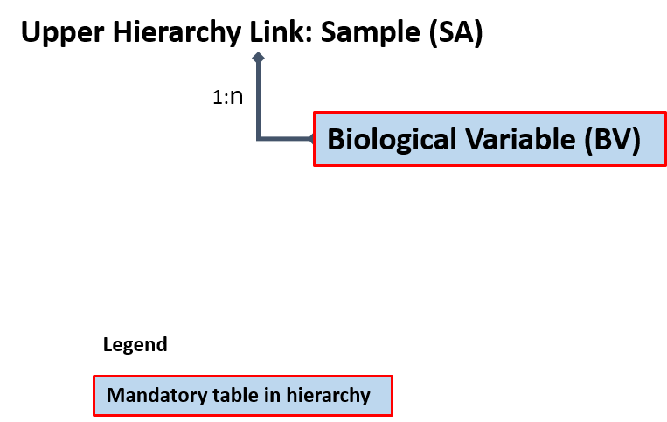
Attempt 2 – Hierarchy 3
Biological Variable
  The individual biological measurements are recorded here. The different types of biological measurements (e.g. length, weight, sex, age etc) are recorded in different columns in our national database so these needed to be “pivoted” into rows.
  In most cases we are carrying out a census at this point so the values of BVtotal and BVsampled are equal – sometimes the value of BVsampled can be different for different types of measurement e.g. we might record the length and weight of all fish, but not the age.

Slide 15
Attempt 3 – Hierarchy 1 Revisited
Hierarchy 3 implies that we are selecting based on time however we are sampling all quarters so this could be misleading.
To resolve the vessel stratification problem with Hierarchy 1 the following approach can be used
  Make use of the “DeStratum” variable in the Design table
  This can be set to Q3 or Q4 and resolves the problem of the same vessel appearing in multiple strata
  This is now the recommended approach for this issue

Slide 16
Attempt 3 – Hierarchy 1 Revisited

Slide 17


